Slide 1
Economic Order Quantity

Slide 2
What is EOQ?
The economic order quantity (EOQ) is a company's optimal order quantity that meets demand while minimizing its total costs related to ordering, receiving, and holding inventory. The EOQ formula is best applied in situations where demand, ordering, and holding costs remain constant over time.

Slide 3
Relevance of EOQ
The economic order quantity (EOQ) is a company's optimal order quantity that meets demand while minimizing its total costs related to ordering, receiving, and holding inventory.
The EOQ formula is best applied in situations where demand, ordering, and holding costs remain constant over time.
One of the important limitations of the economic order quantity is that it assumes the demand for the company’s products is constant over time.

Slide 4
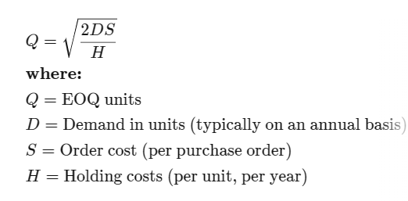
Formula for Calculating Economic Order Quantity (EOQ)

Slide 5
What the Economic Order Quantity Can Tell You
The goal of the EOQ formula is to identify the optimal number of product units to order. If achieved, a company can minimize its costs for buying, delivering, and storing units. The EOQ formula can be modified to determine different production levels or order intervals, and corporations with large supply chains and high variable costs use an algorithm in their computer software to determine EOQ.

Slide 6
Limitations of EOQ
The EOQ formula assumes that consumer demand is constant. The calculation also assumes that both ordering and holding costs remain constant. This fact makes it difficult or impossible for the formula to account for business events such as changing consumer demand, seasonal changes in inventory costs, lost sales revenue due to inventory shortages, or purchase discounts a company might realize for buying inventory in larger quantities.

Slide 7
Example
Assume, for example, a retail clothing shop carries a line of men’s jeans, and the shop sells 1,000 pairs of jeans each year. It costs the company $5 per year to hold a pair of jeans in inventory, and the fixed cost to place an order is $2.

Slide 8
Solution
The EOQ formula is the square root of (2 x 1,000 pairs x $2 order cost) / ($5 holding cost) or 28.3 with rounding. The ideal order size to minimize costs and meet customer demand is slightly more than 28 pairs of jeans. A more complex portion of the EOQ formula provides the reorder point.

Slide 9
Why Is Economic Order Quantity Important?
Economic order quantity is important because it helps companies manage their inventory efficiently.
Without inventory management techniques such as these, companies will tend to hold too much inventory during periods of low demand while also holding too little inventory during periods of high demand. Either problem creates missed opportunities.

Slide 10
Problem 1
The John Equipment Company estimates its carrying cost at 15% and its ordering cost at $9 per order. The estimated annual requirement is 48,000 units at a price of $4 per unit. Find out EOQ (Ans 1200 units)

Slide 11
Problem 2
A manufacturing company places a semi-annual order of 24,000 units at a price of $20 per unit. Its carrying cost is 15% and the order cost is $12 per order. Find EOQ (Ans 620 units)

Slide 12
Thank You

